Slide 1

Labor Management 04/25/2023 – Rodrigo Malucho

Slide 2

Agenda
What Does the Label Management stands for ?
Understanding Label Management first
When it is used ?
When it is not used ?
Overview Regarding Time consuming by Resource
Transaction codes normally used
Q&A

Slide 3
What is Labor Management
Labor management helps you to plan labor times and resources in your warehouse more effectively, thereby making your warehouse more productive.
After planned work is executed in the warehouse, a comparison can be made of the planned versus the actual times
Labor management tool can be used to record and measure employee’s productivity and you can also visualize reports in warehouse cockpit based on key figures.
Using Labor management, you can also compare productivity of the warehouse employees

Slide 4
What is Labor Management
When one warehouse order is about to be confirm by a resource, the system will start to record the date and time and when warehouse order is confirmed the system finished the date and time it took to complete the warehouse and its warehouse tasks.
Then time consuming will be used furthermore for measures and comparison

Slide 5
When it is used ?
When you want to have a visibility (measure) regarding how much time it is pending to perform each kind of activity on the warehouse like:
Putaway
Picking
Internal movements (like inventory / bin to bin)
Load
Etc
When you want to check report to check the time consuming or measure the efficiency for a resource

Slide 6
When it is not used ? (not useful)
When the volume of operation on the warehouse is low
When there is no so many resources working per shift (small operation)
When you decide that monitoring the time spending versus the volume of operation in warehouse will not add any value or will not help reduce costs somehow.

Slide 7
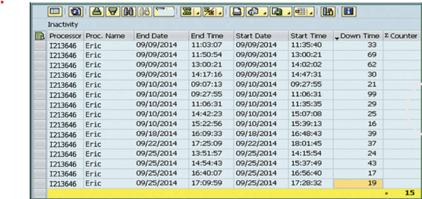
Overview about time consuming
This is a example regarding the reports to measure the time consuming when you do have labor management activated for Warehouse

Slide 8
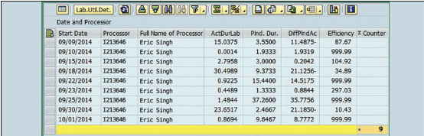
Overview about time consuming
This is a example regarding the reports to measure the time consuming for resource when you do have labor management activated for Warehouse

Slide 9
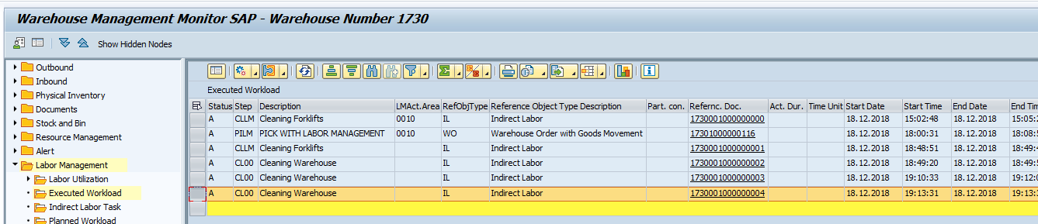
Overview about time consuming
This is a example regarding the reports to measure the time consuming for resource when you do have labor management activated for Warehouse

Slide 10
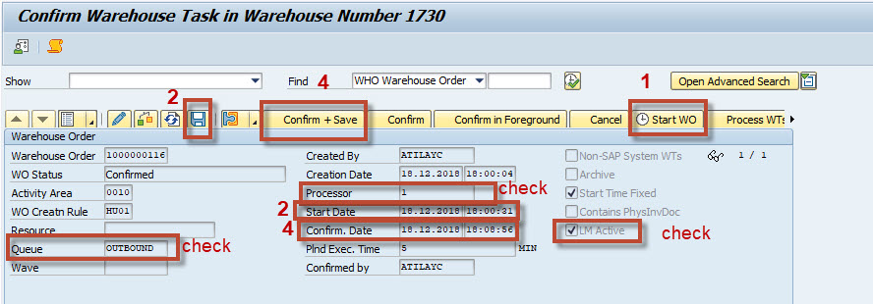
Overview about confirm a Warehouse tasks with Labor Management active
In case you are using the monitor in order to confirm warehouse task

Slide 11
Transaction Codes
Check Labor Management Reports – /SCWM/MON
Report direct time consuming for warehouse orders – /SCWM/TO_CONF
Report direct time consuming for warehouse orders – /SCWM/RFUI
Report indirect time (indirect labor) – /SCWM/RFUI

Slide 12


Slide 13
APPENDIX

